Slide 1
CENTRUM KSZTAŁCENIA ZAWODOWEGO I USTAWICZNEGO W MORAWICY

Slide 3
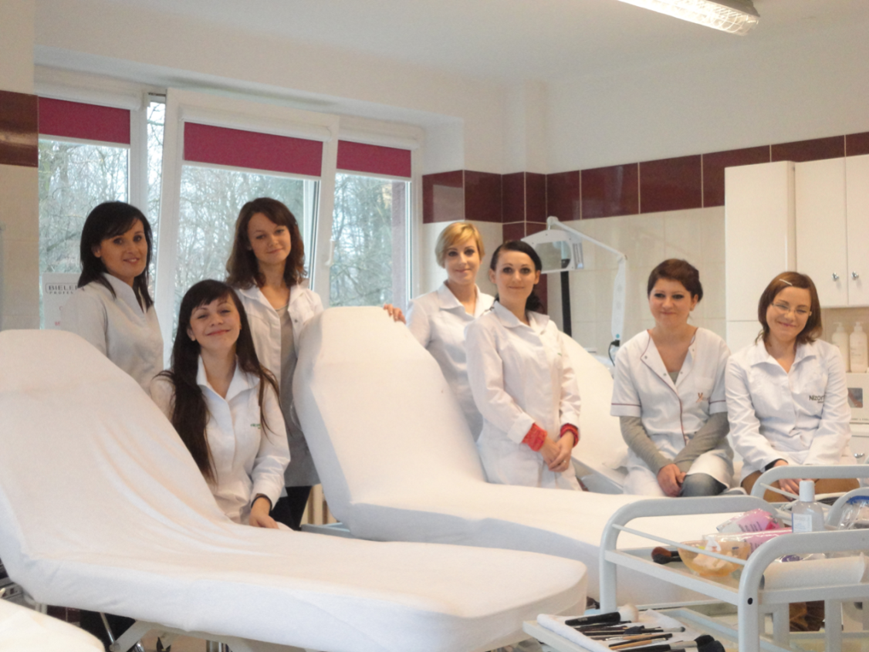
Beauty Therapy Techniques

Slide 4
Beauty Therapy Techniques
2 qualifications in 4 semesters:
A.61 Face Treatments and Make Up
A.62 Manicure, Pedicure and Body Treatments

Slide 5
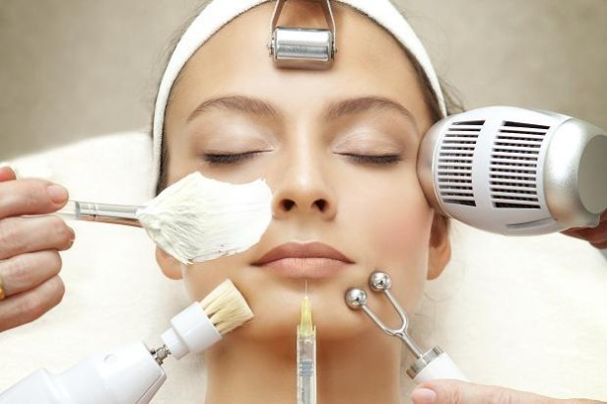
A.61 Face Treatments & Make Up
Facial Skincare (rebalance, hydrate, nourishing, moisture, anti wrinkle and revitalise)
Skin Analysis
Facial Treatments (microdermabrasion. Galvanic, ultrasonic skin scrubber, mesotherapy, RF, brushing)
Facial Massage
Remove Hair Using Waxing Techniques
Eyelash and Brow Treatments
Facial Electrotherapy Treatments
Make up
Client Care and Communication in Beauty Related Industries

Slide 6
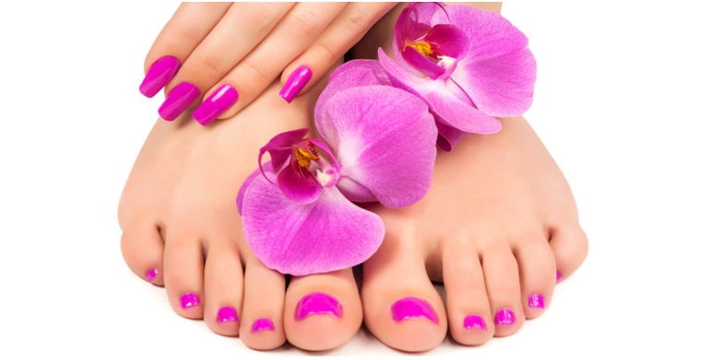
A.62 Manicure, Pedicure and Body Treatments
Manicure Treatments
Nail Art
Pedicure Treatments
Paraffin Wax Treatmenrs
Body Massage
Hot Stone Massage
Chinese Cup Massage
Body Electrotherapy Treatments
Remove Hair Using Waxing Techniques
Body Slimming Treatments, Anti-cellulite Treatments, Body Wrapping

Slide 7
Subjects:
Anatomy and Physiology of the whole body
Cosmetology
Dermatology
Salon Management Fundamentals
Diet and Nutrition
Basic First Aid
Physiotherapy
Chemistry
English language

Slide 8
You will learn, develop and practice the skills required for employment and/or career progression in the beauty sector. Learning will take place in both the classroom
You will develop your understanding of the wide range of practices and procedures needed to work in the exciting beauty therapy industry such as providing facial skincare, waxing, massage, manicure, pedicure and health and safety.

Slide 9
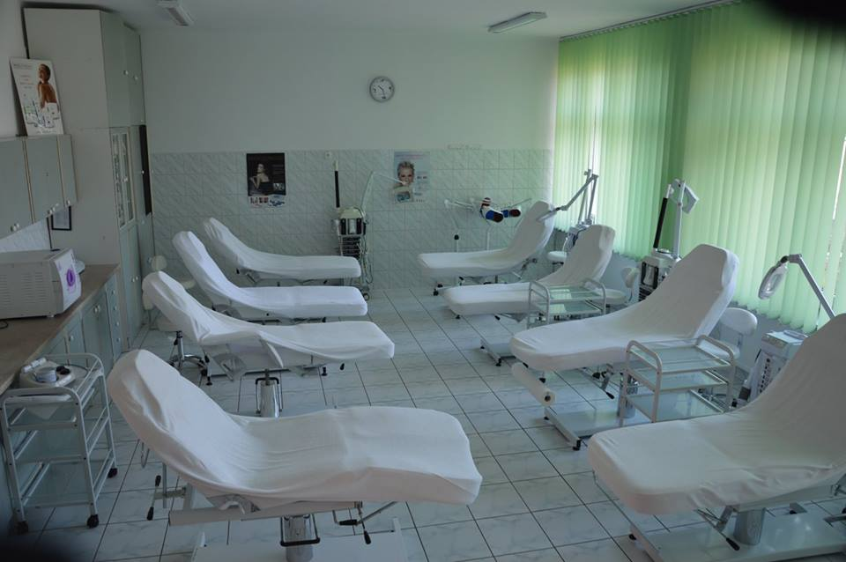
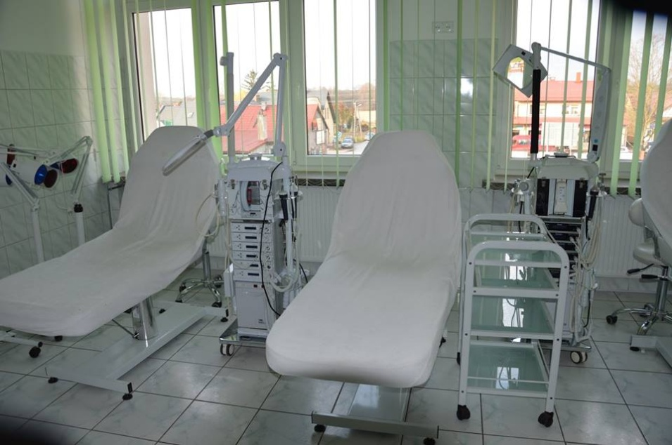
FACIAL AND BODY TREATMENTS

Slide 10
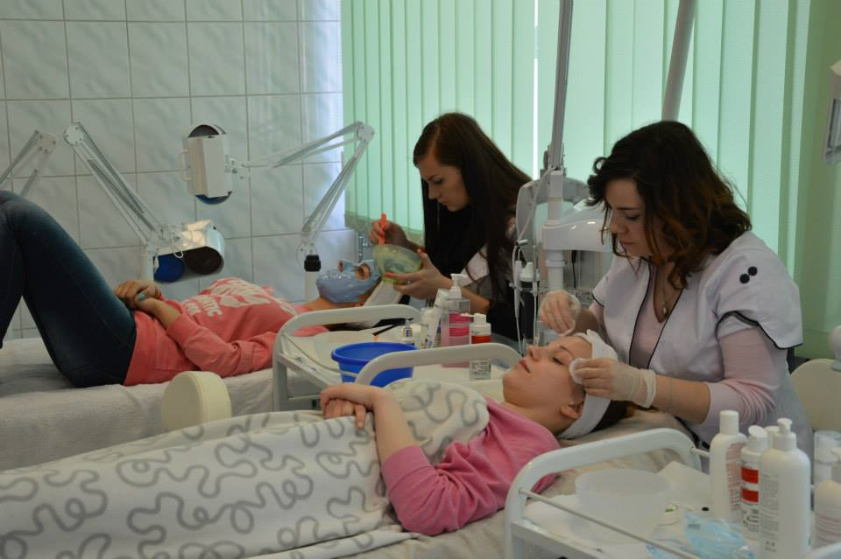
FACIAL TREATMENTS

Slide 11
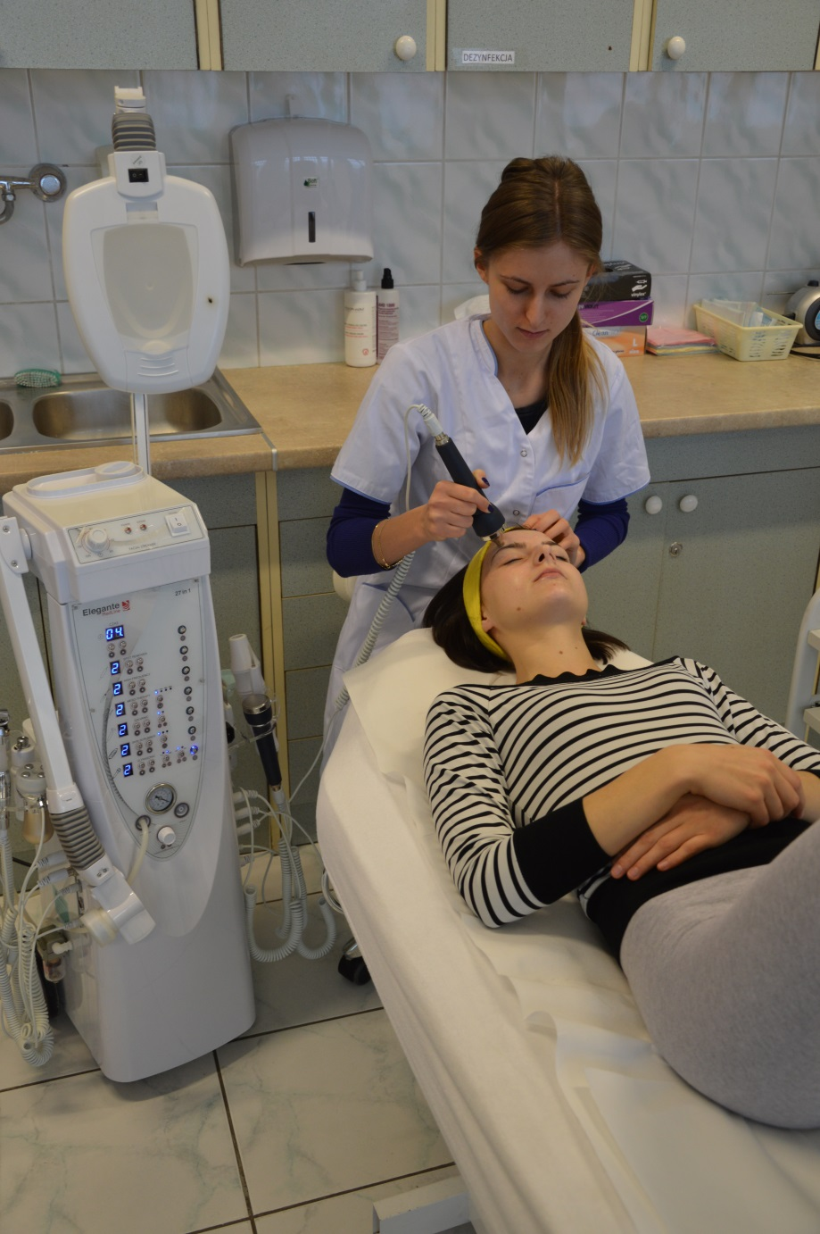
Mesotherapy treatment

Slide 12
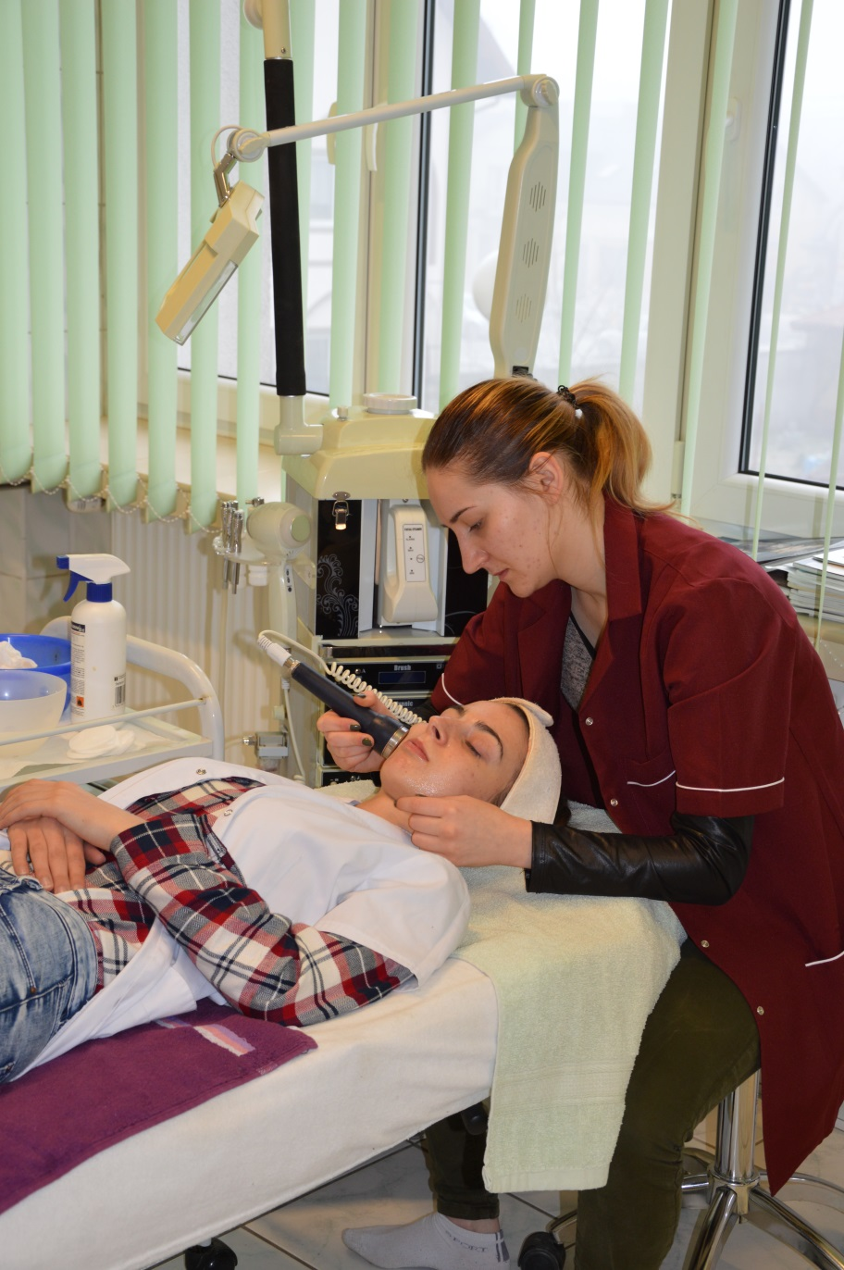

Slide 13
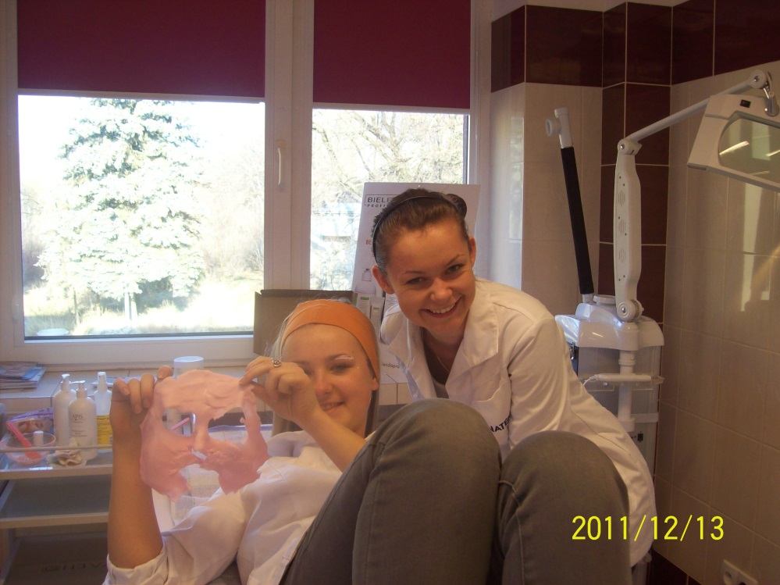
Algae Mask

Slide 14
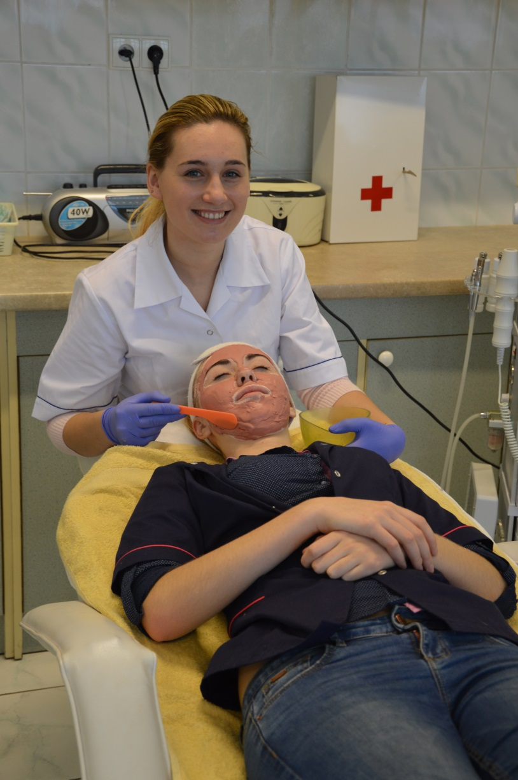
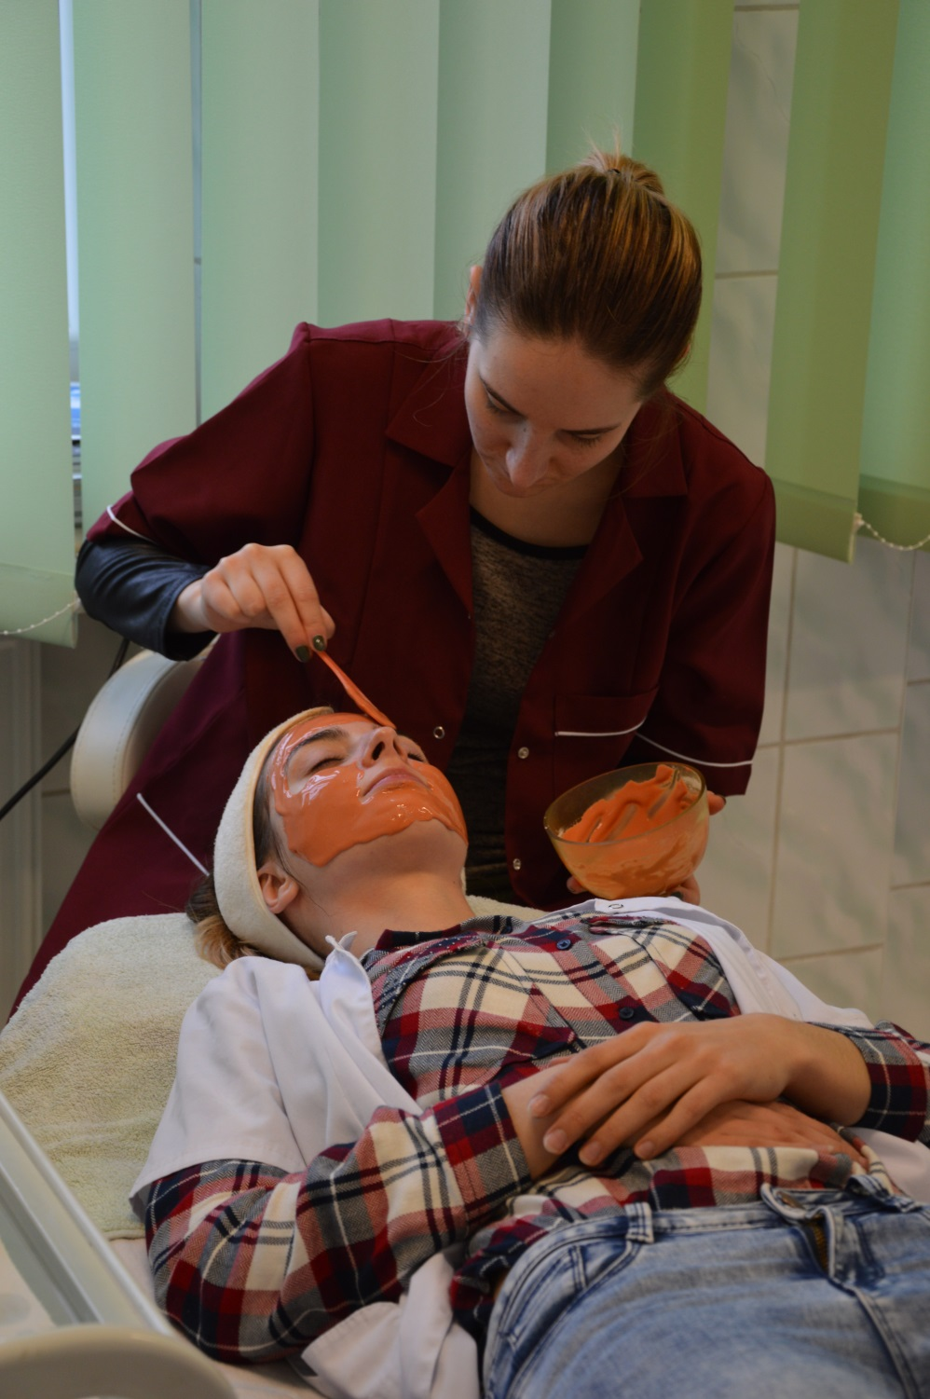

Slide 15
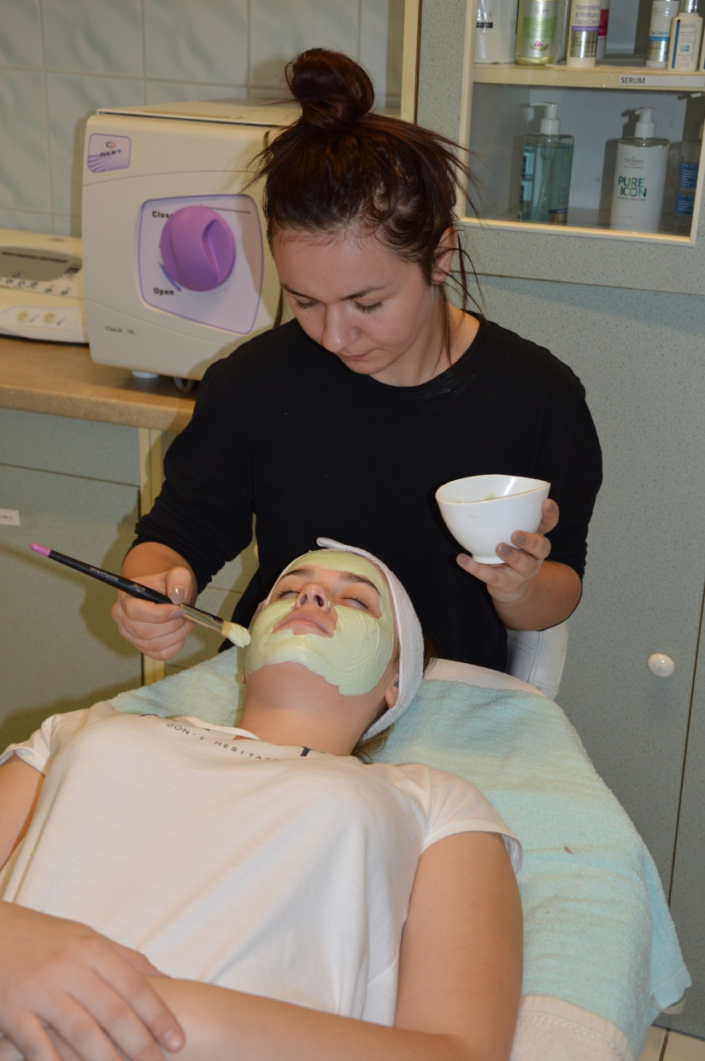
Cream mask

Slide 16
Galvanic Facial Treatment

Slide 17
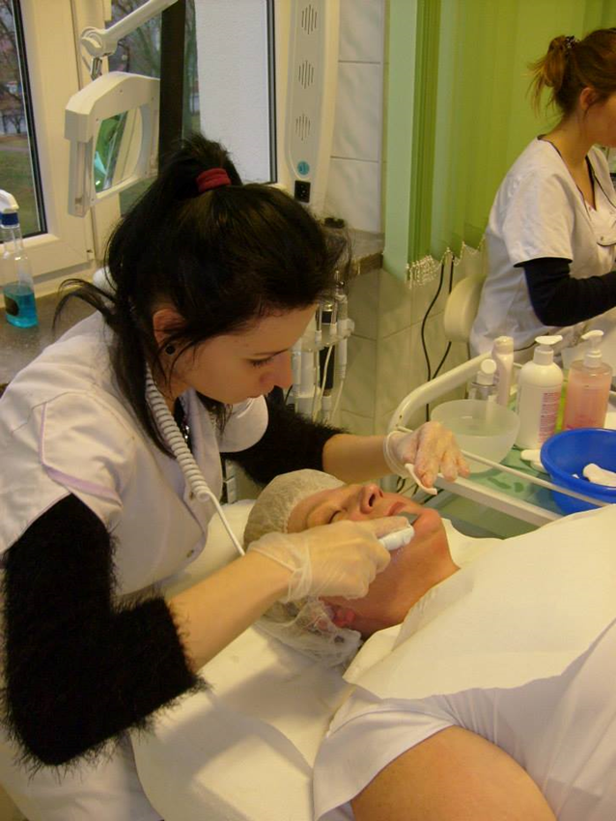
Ultrasonic Skin Scrubber

Slide 18
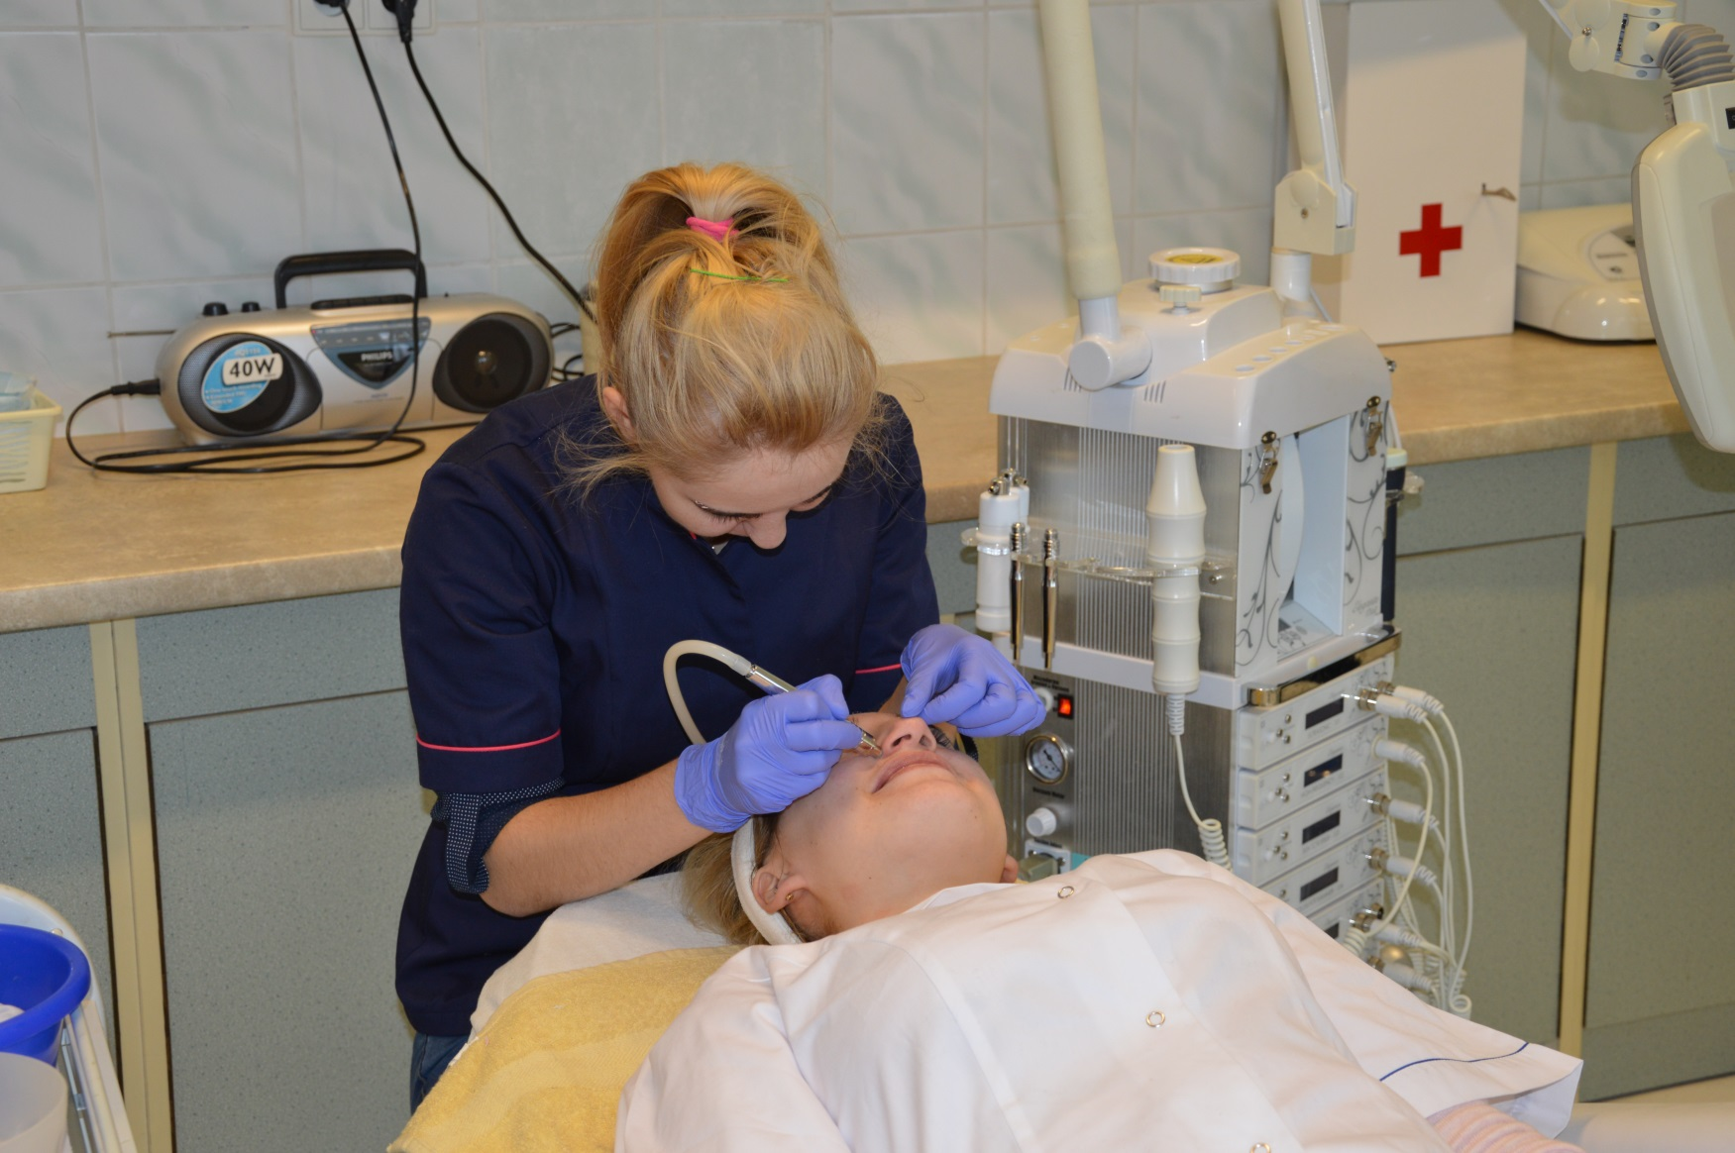
Microdermabrasion

Slide 19
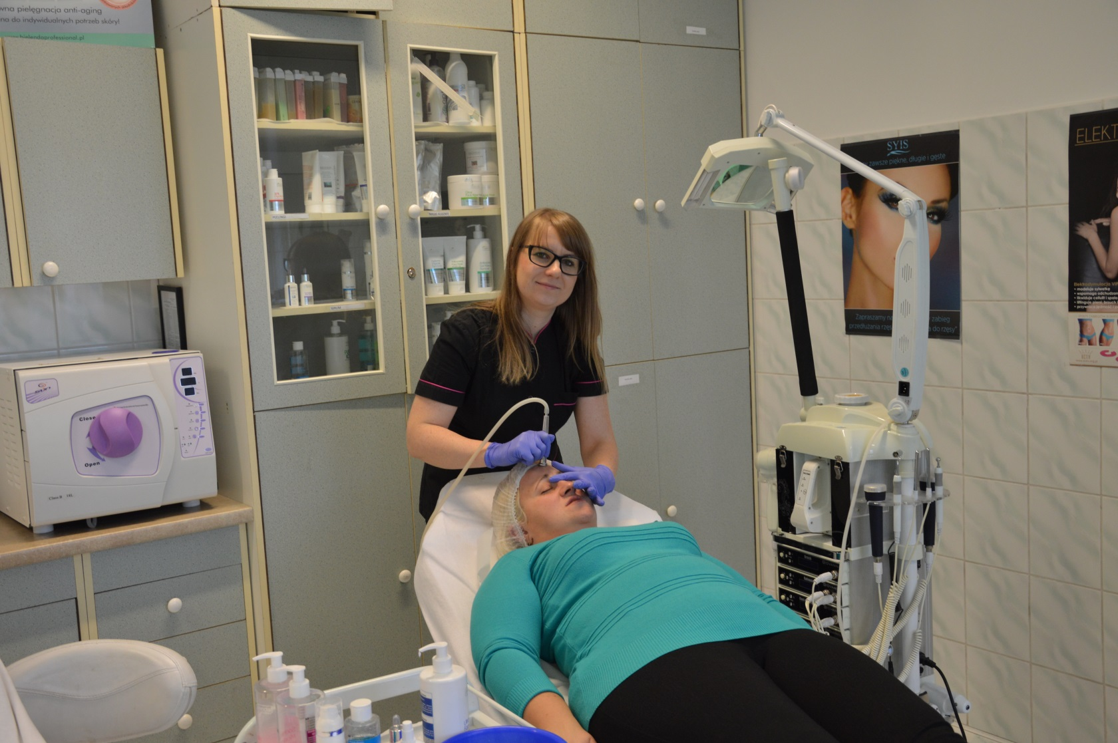
Microdermabrasion

Slide 20
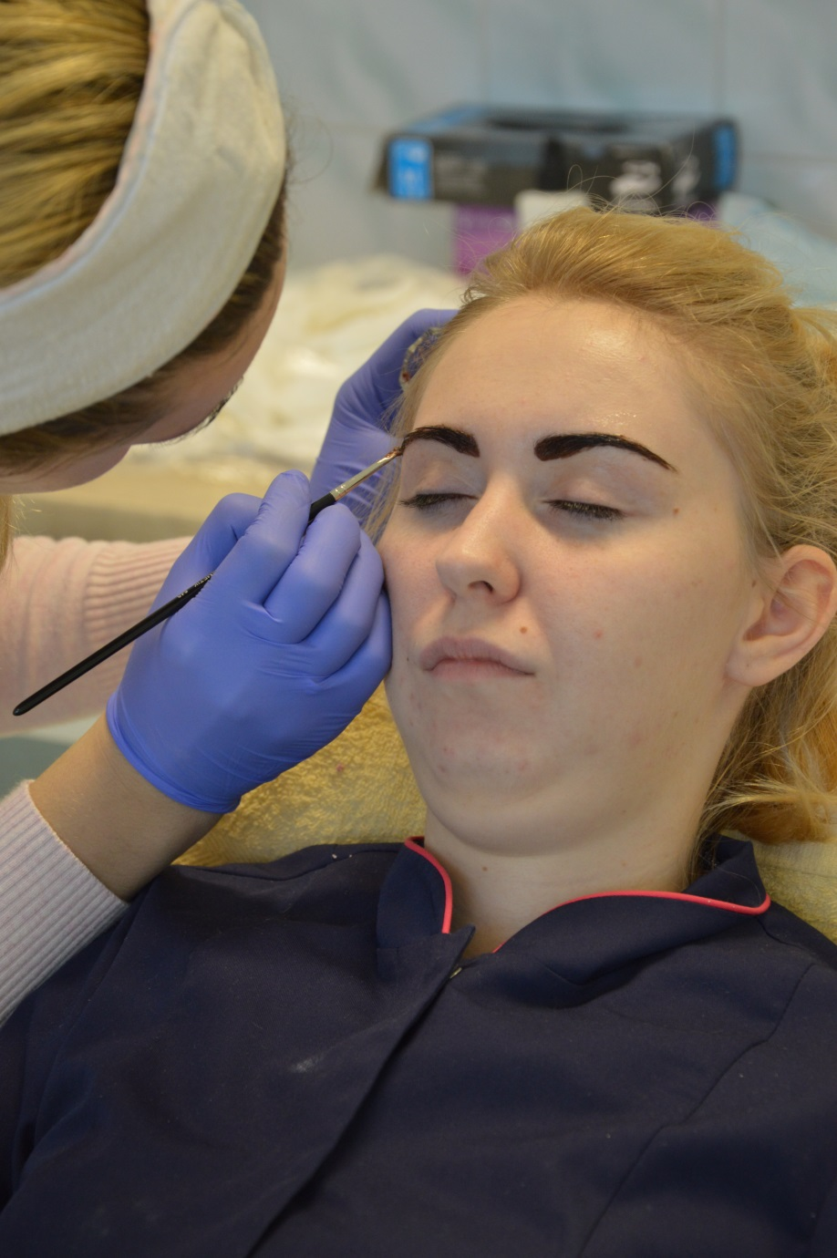
Eyebrow Tinting Eyelash Tinting

Slide 21
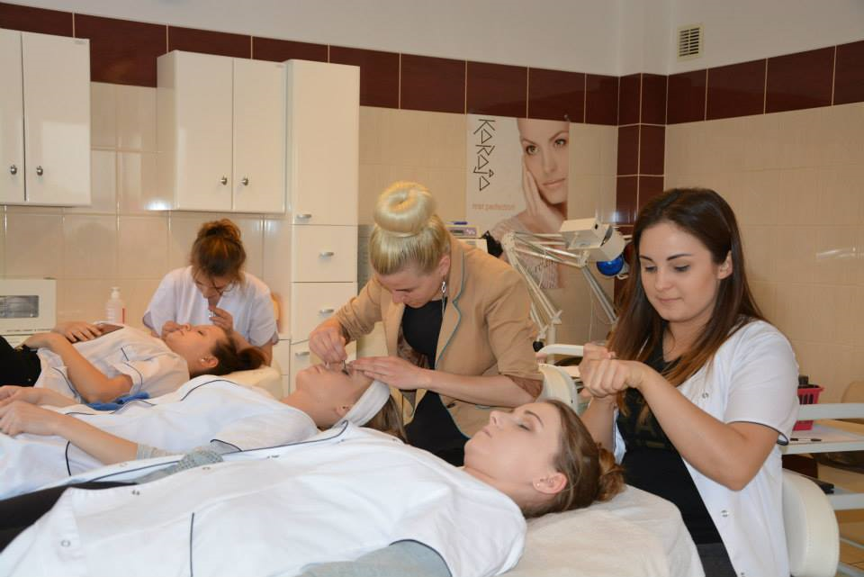
Eyelash extension

Slide 22
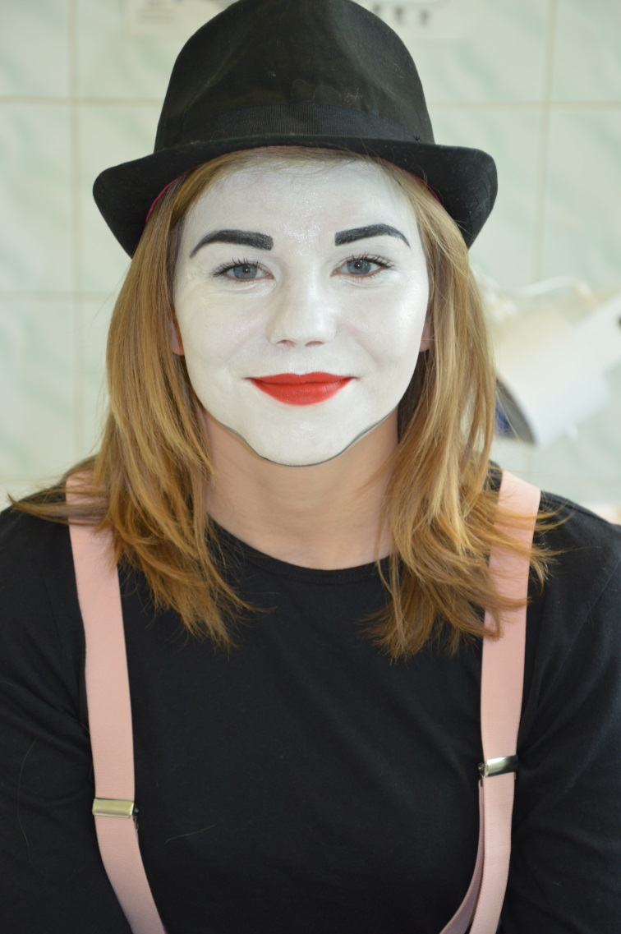
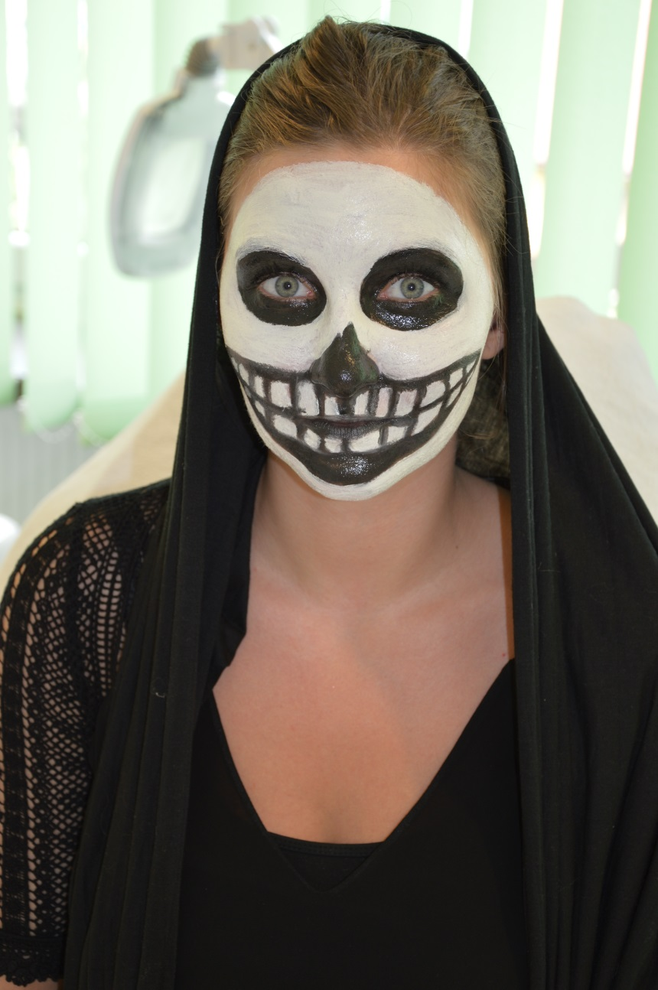
Make up

Slide 23
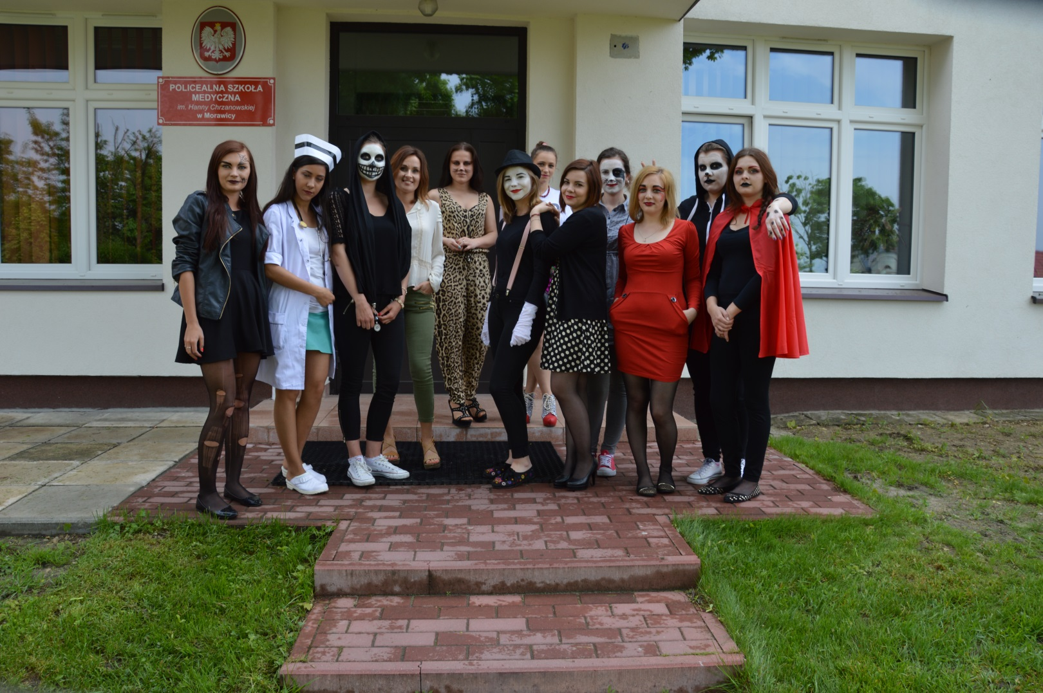
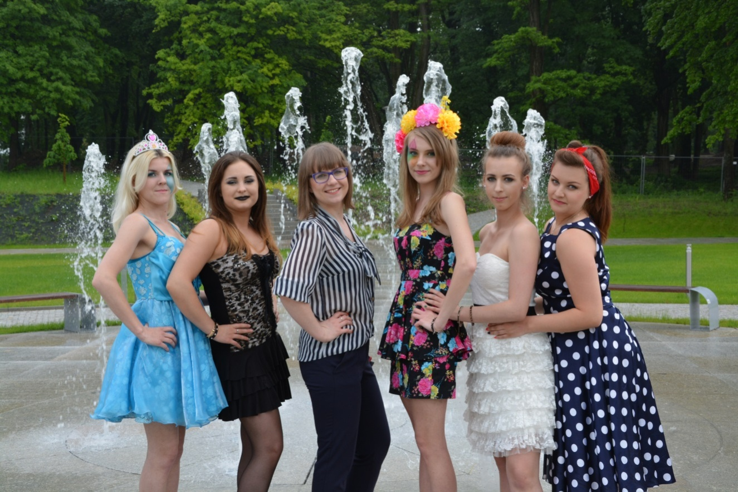

Slide 24
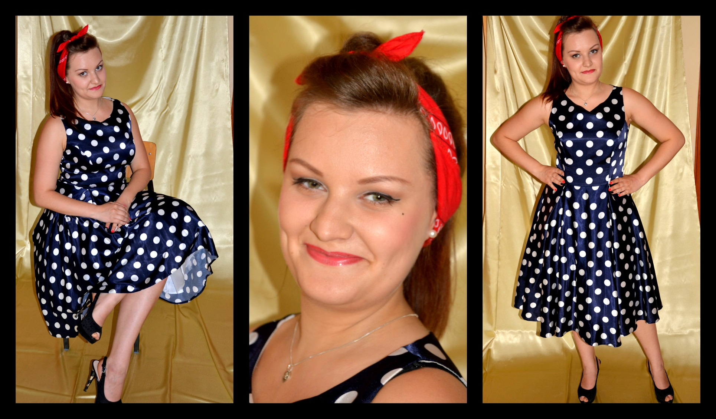

Slide 25
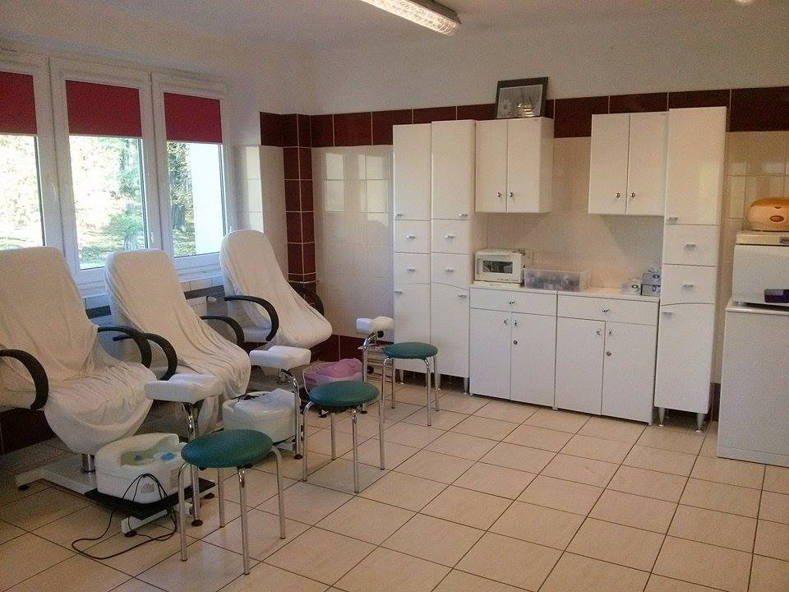
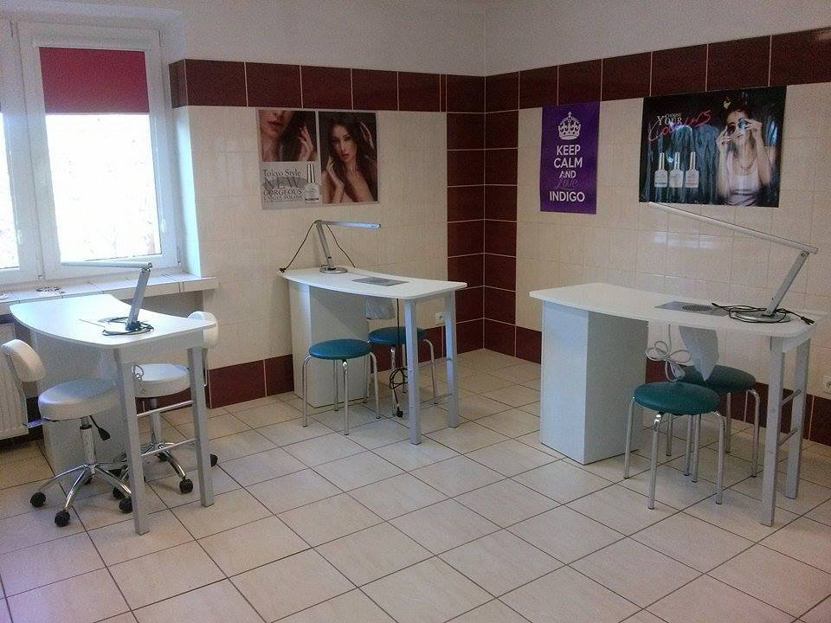
Manicure & Pedicure Classroom

Slide 27
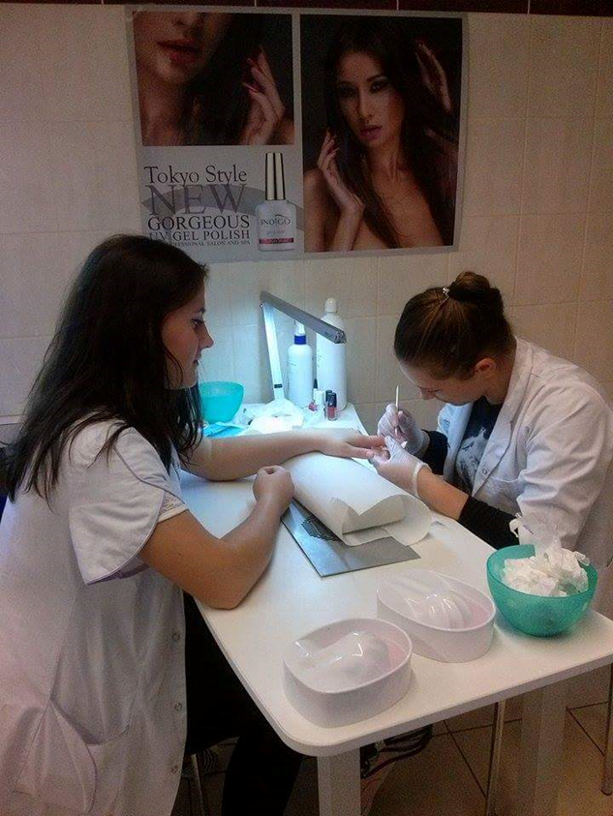
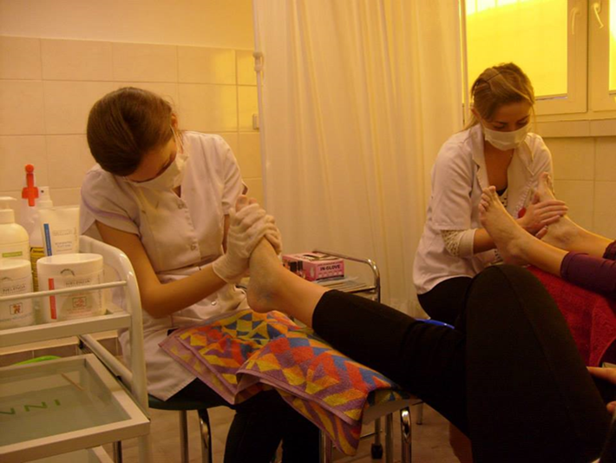
Manicure & Pedicure

Slide 28
BRANDS

Slide 29
Centrum Kształcenia Zawodowego i Ustawicznego w Morawicy ul. Kielecka 7 26-026 Morawica (woj. świętokrzyskie) e-mail: szkolamedyczna@o2.pl www.szkola-medyczna.com.pl

Slide 30
Thank you for your attention!

